Slide 1
Practical Machine Learning
Optimization - Reinforcement Learning

Slide 2
Today we cover
Hyperparameters
Optimizers
Regularizers
….
Data Augmentation
Tune your model

Slide 3
Warning
This is not science and advise is more common practice than strict rule.

Slide 4
Hyper parameters
The aspects of the model we do not learn:
Network architecture
Learning rate
Optimizers
Regularizers
Initialization

Slide 5
Network Architecture
Number of layers, size of layers, ...

Slide 6
Network capacity
The amount of free parameters you have in your model
The more parameters the more complex functions you can represent
Use big nets with big data
Beware of overfitting

Slide 7
Overfitting
Your network has too many parameter
Too few data points
Can be solved with regularizers

Slide 8
How to know
Test performance < Train performance => Overfitting
Make network smaller
Add regularizer
Test per = Train perf < Desired result => Underfitting
Increase network size

Slide 9
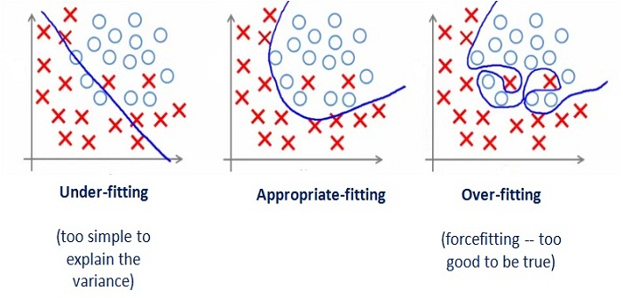

Slide 10
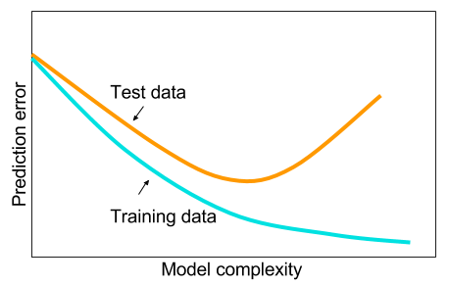

Slide 11
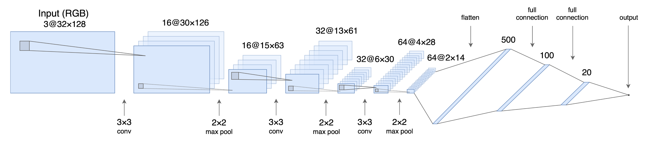
State of the art architecture

Slide 12
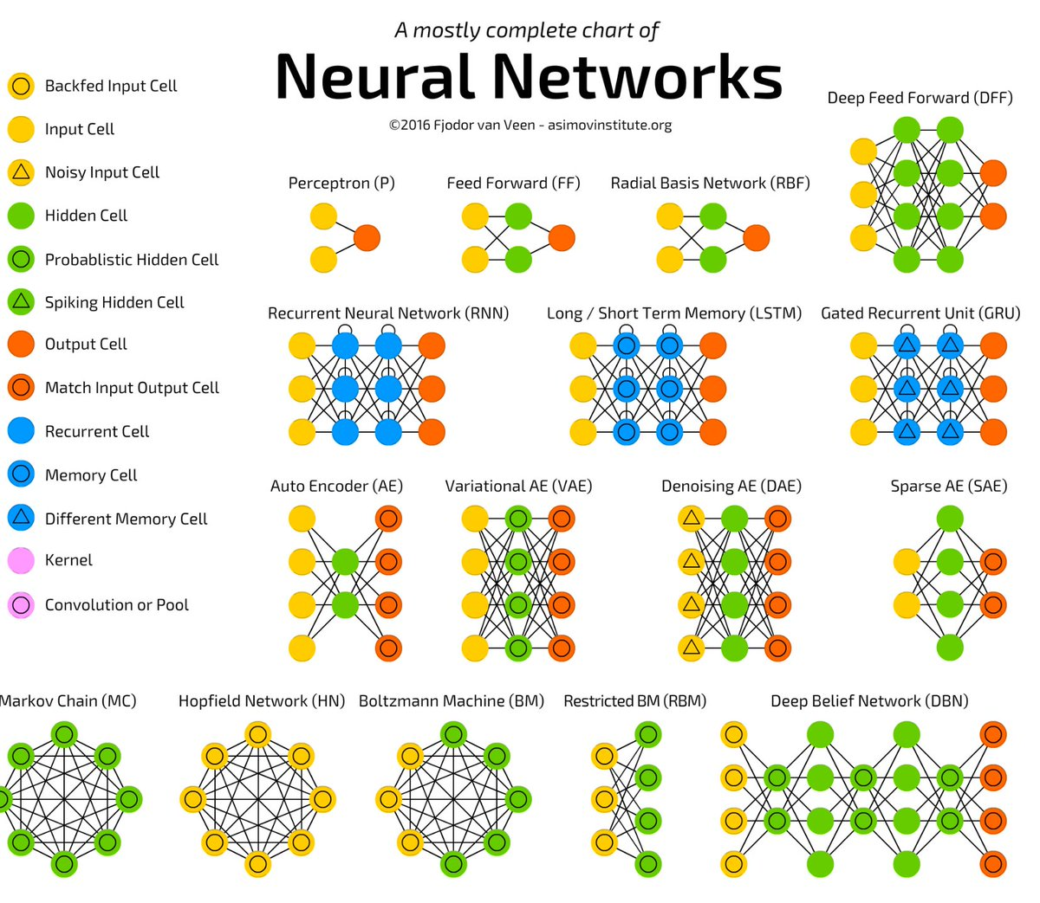

Slide 13
Learning rate
How much to update model at each step

Slide 14
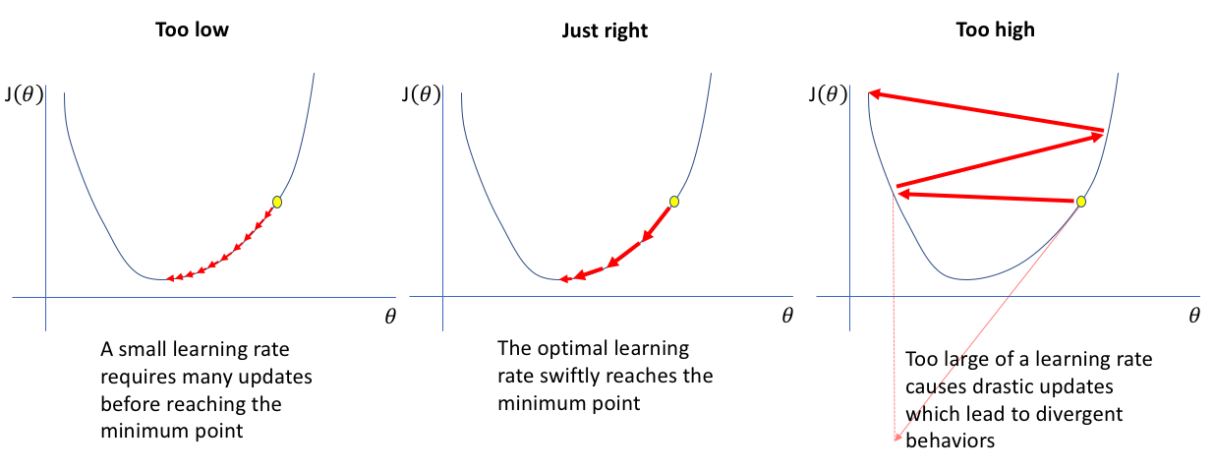

Slide 15
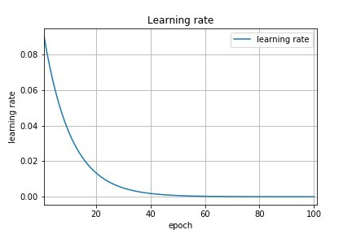

Slide 16
Activation Functions
Add non-linearity

Slide 17
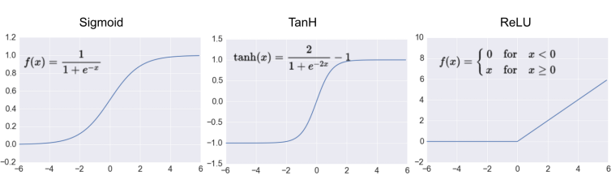

Slide 18
Choose activation function
Use ReLU as default
If you need to try test:
ReLU
Sigmoid
TanH
Softmax at the last layer of a classifier

Slide 19
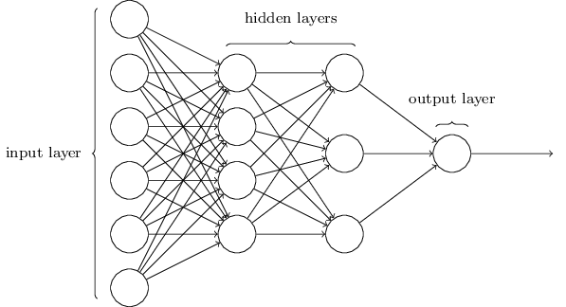
the
black
cat
mat
sat
on
the

Slide 20
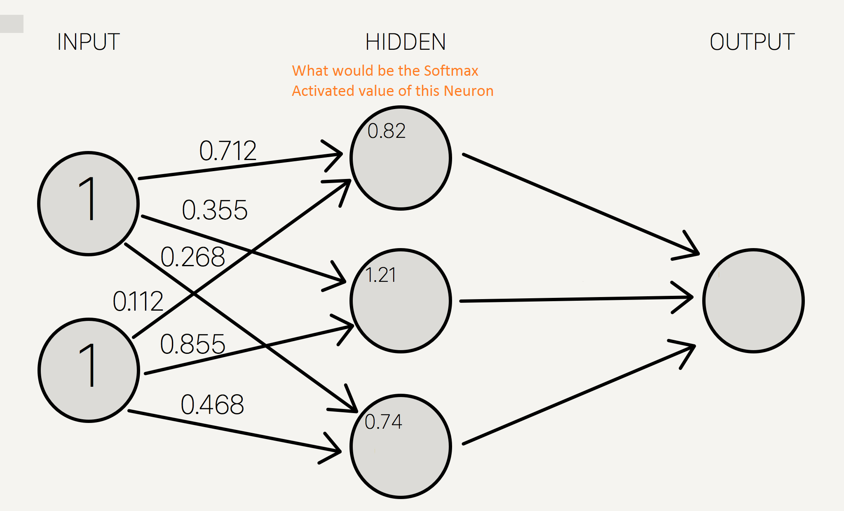
Softmax example

Slide 21
Optimizer
Converts your loss to a weight update

Slide 22
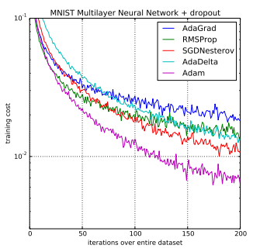

Slide 23
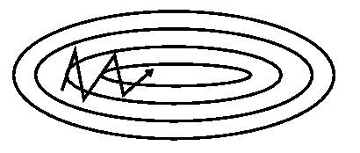

Slide 24
Choose optimizier
Use Adam as default
If you need to try test:
Adam
RMSprop
Adagrad

Slide 25
Regularizers
Shape your model

Slide 26
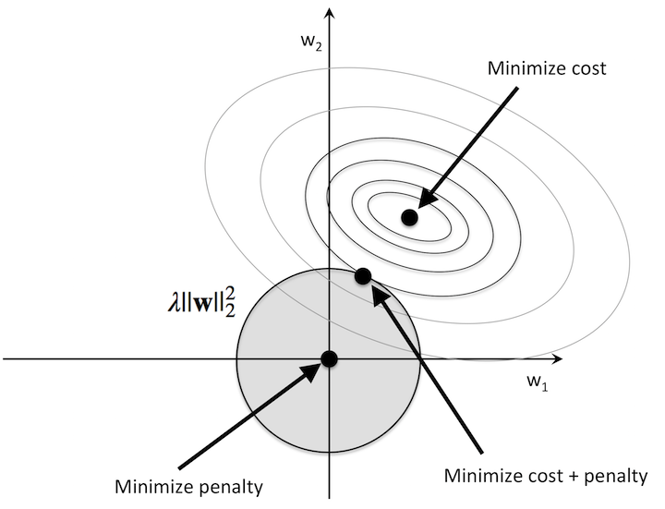

Slide 27
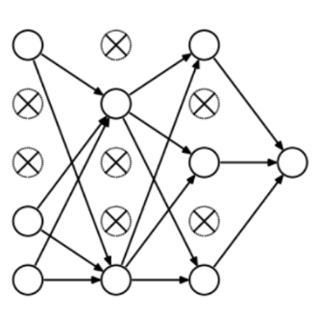
Dropout

Slide 28
Code
from keras import regularizers
model.add(Dense(64, input_dim=64, kernel_regularizer=regularizers.l2(0.01), activity_regularizer=regularizers.l1(0.01)))
model.add(Dropout(0.5))

Slide 29
How to use regularizers
Apply when overfitting
Use L2 over L1 in most cases
Use dropout with 50% as default

Slide 30
Initializers
Initial weights of your network.

Slide 31
The problem with Zero
All weights are the same
Neurons are deactivated
It takes a long time to break the symmetry
Solution:
Random weights

Slide 32
Keras initializers
Zeros: Initializer that generates tensors initialized to 0.
Ones: Initializer that generates tensors initialized to 1.
Constant: Initializer that generates tensors initialized to a constant value.
RandomNormal: Initializer that generates tensors with a normal distribution.
RandomUniform: Initializer that generates tensors with a uniform distribution.
TruncatedNormal: Initializer that generates a truncated normal distribution.
VarianceScaling: Initializer capable of adapting its scale to the shape of weights.
Orthogonal: Initializer that generates a random orthogonal matrix.
Identity: Initializer that generates the identity matrix.
lecun_uniform: LeCun uniform initializer.
glorot_normal: Glorot normal initializer, also called Xavier normal initializer.
glorot_uniform: Glorot uniform initializer, also called Xavier uniform initializer.
he_normal: He normal initializer.
lecun_normal: LeCun normal initializer.
he_uniform: He uniform variance scaling initializer.

Slide 33
How to use initializers
Keras initializes to glorot_uniform
RandomNormal is commonly used
Test He initializer as it is showing great results
Bias initialization can be left at default

Slide 34
Code
model.add(Dense(64, kernel_initializer='random_uniform', bias_initializer='zeros'))

Slide 35
You code
Get text
Build next word predictor

